Slide 1
MERN
Mahhek Tahir
Notes:
.

Slide 2
What is MERN/MEAN stack
MERN stack developers hold knowledge of MongoDB, Express.JS, React.js and Node.JS
MEAN stack developers hold knowledge of MongoDB, Express.JS, Angular.js and Node.JS

Slide 3
MERN
MongoDB — document database
Express.js — Node.js web framework
React.js — a client-side JavaScript
Node.js — JavaScript web server
MERN is used to build full-stack applications where:
✅ React.js handles the frontend (UI)
✅ Express.js & Node.js handle the backend (API & server logic)
✅ MongoDB stores and manages data

Slide 4
Why MERN?
🔹 Single Language (JavaScript) – No need to switch between languages for frontend & backend
🔹 Fast & Scalable – Non-blocking architecture of Node.js ensures efficiency
🔹 MongoDB is Schema-less – Flexible and easy-to-use database
🔹 React’s Component-Based Architecture – Reusable UI components
🔹 Full-Stack Development – Everything in one ecosystem

Slide 5
MERN - Architecture
React.js
WEB
Node.js
Express.JS
SERVER
Mongo DB
DATABASE

Slide 6
React.js front end
Creates dynamic client-side application in HTML.
It let you build complex interface through simple components, connect them to data on your back-end server, and render them as HTML

Slide 7
Node.js
Node.js is a JavaScript runtime built on Chrome’s V8 engine that allows you to run JavaScript outside the browser.
It enables server-side development using JavaScript.
Supports asynchronous, event-driven programming, making it fast and efficient for handling multiple requests.
Non-blocking I/O – Handles multiple requests at once.
Single Programming Language – JavaScript for both frontend (React) & backend.

Slide 8
Express.js
Express.js is a lightweight and flexible framework built on top of Node.js.
It simplifies server-side development by providing easy-to-use APIs for handling requests, routing, and middleware.
Makes building RESTful APIs and web applications much faster and easier.

Slide 9
MongoDB Database
Data in the format of JSON can be sent by React.js to Express.js, where the process data stores directly in MongoDB for later retrieval.
MongoDB is a NoSQL database that stores data in a flexible, JSON-like format called BSON (Binary JSON). Unlike traditional SQL databases (like MySQL or PostgreSQL), MongoDB does not use tables and rows. Instead, it stores data in collections and documents, making it more scalable and flexible.

Slide 10
Virtual DOM
The Virtual DOM (VDOM) is a lightweight copy of the Real DOM that React uses to efficiently update the UI without directly modifying the actual browser DOM.

Slide 11
Virtual DOM
React doesn’t update the Real DOM immediately.
Instead, it creates a Virtual DOM, which is just a JavaScript object representation of the UI.
When state or props change, React creates a new Virtual DOM.
React compares (diffs) the new Virtual DOM with the previous one to find the exact changes.
Instead of re-rendering the entire UI, React updates only the changed elements in the Real DOM.

Slide 12
Benefits of Virtual DOM
✔ Faster updates than directly modifying the Real DOM ✔ Improves performance & efficiency ✔ Makes React apps smooth & responsive
MERN is a powerful and efficient stack that helps developers build fast, scalable, and modern web applications quickly and effectively!

Slide 13
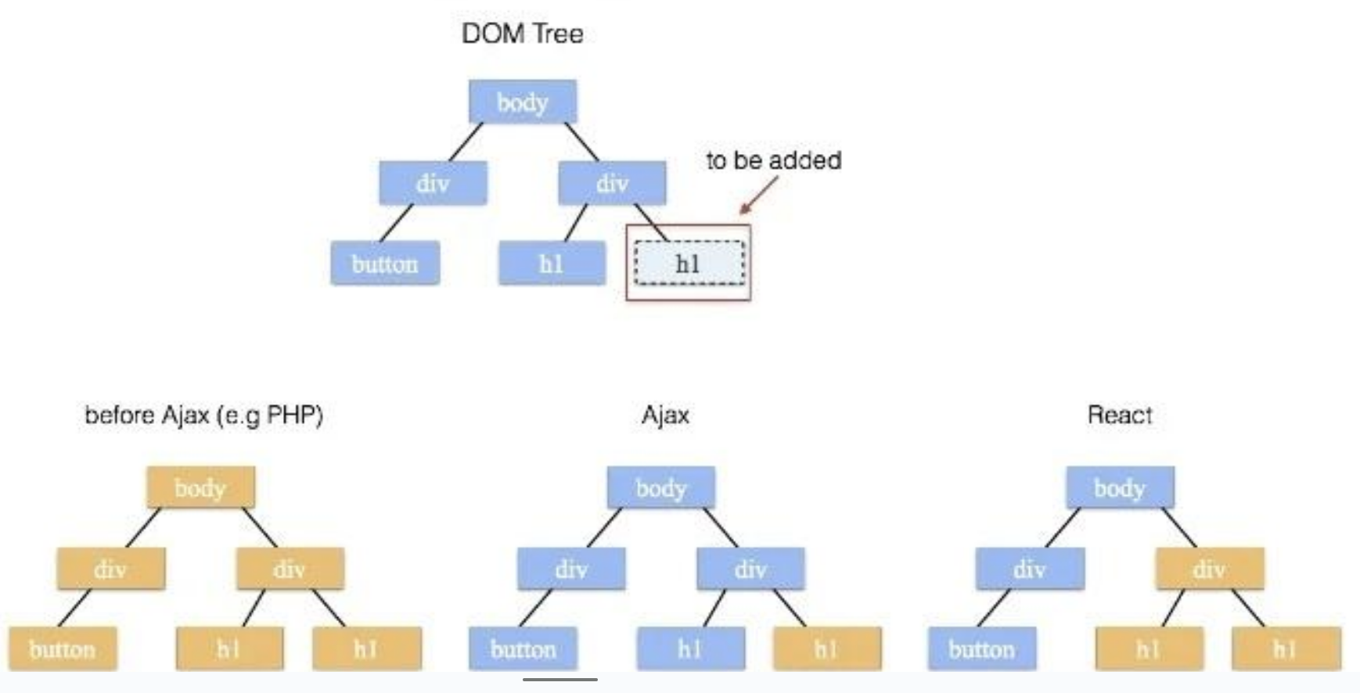
React DOM

Slide 14
Virtual DOM Advantages
🔸 Without Virtual DOM (Direct DOM Updates)
Changing a small part of a webpage requires re-rendering the whole DOM.
This causes slow performance and flickering effects.
🔸 With Virtual DOM (React's Approach)
React creates a Virtual DOM and detects changes.
Instead of updating everything, React only updates the changed elements.
The Real DOM gets updated only where needed, improving efficiency.

Slide 15
System Design
Notes:
html

Slide 16
Monolith
A single-tiered software application in which the user interface and data access code are combined into a single program from a single platform. - Wikipedia
Notes:
Example: Single java jar file

Slide 17
Monolith
Pros
Simple
Single Code Base
Resource efficient at small scale
Cons:
Modularity is hard to enforce as app grows
Scaling is a challenge
Long release cycles
Slow to react to customer demand
Notes:
Can you use API with monolith?

Slide 18
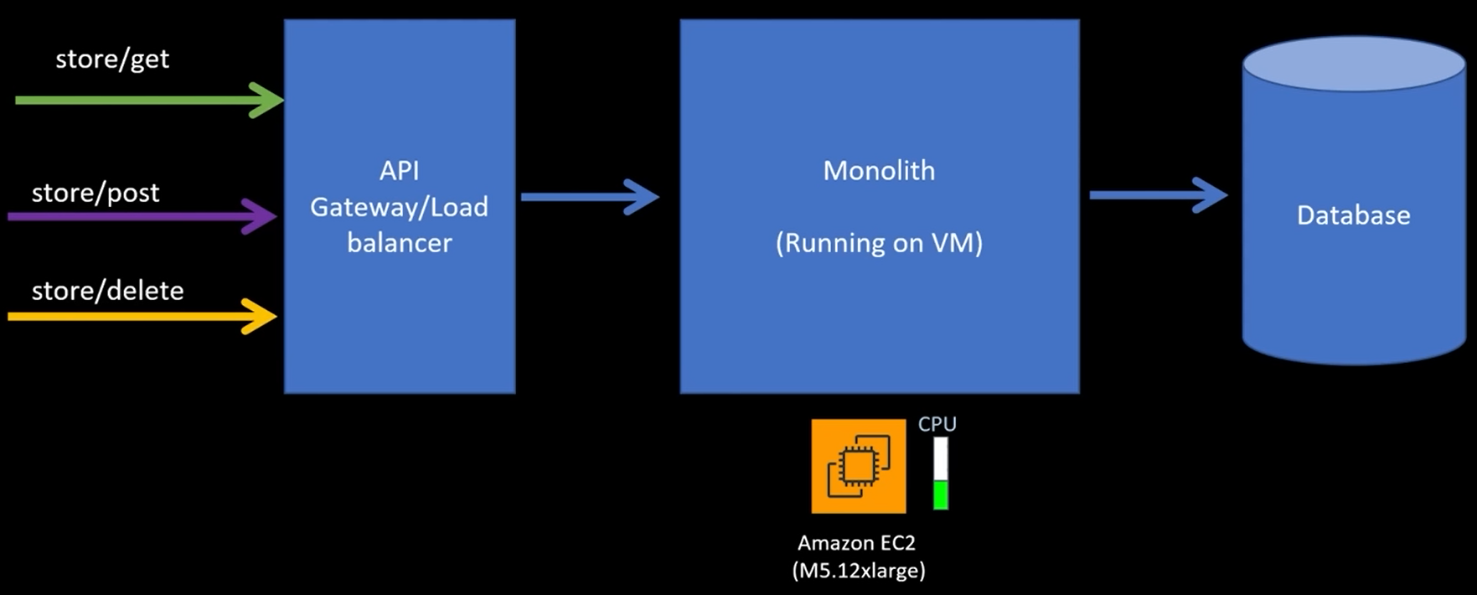
Issue of scaling

Slide 19
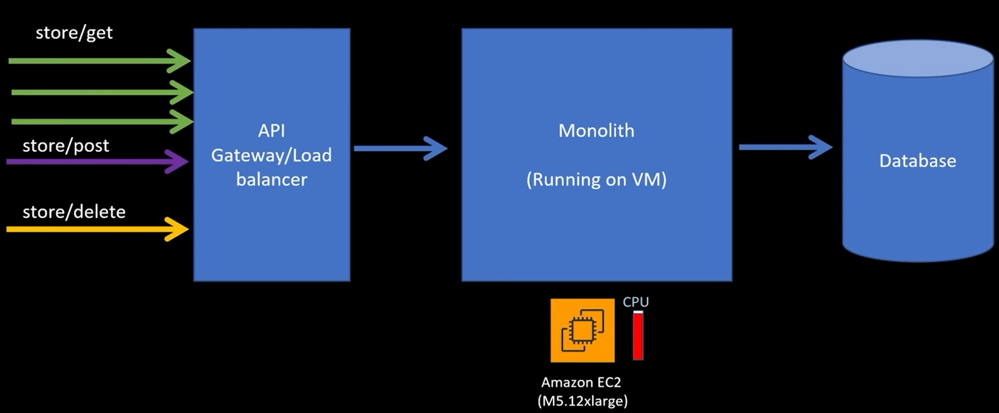
Issue of scaling

Slide 20
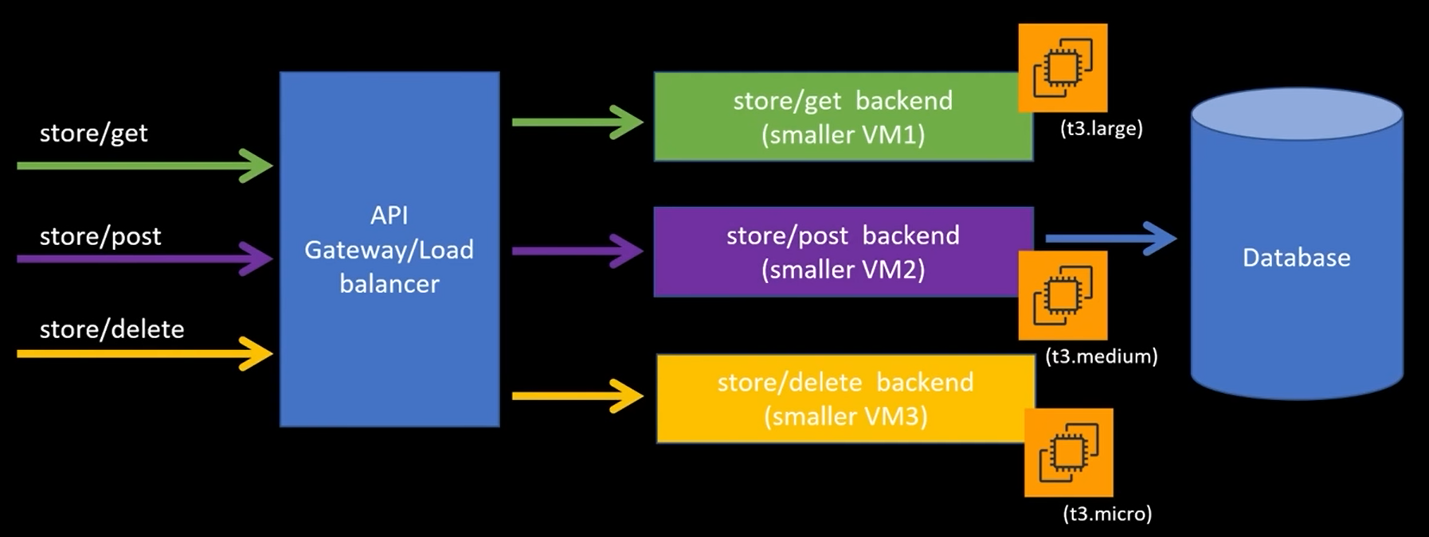
Solution of scaling

Slide 21
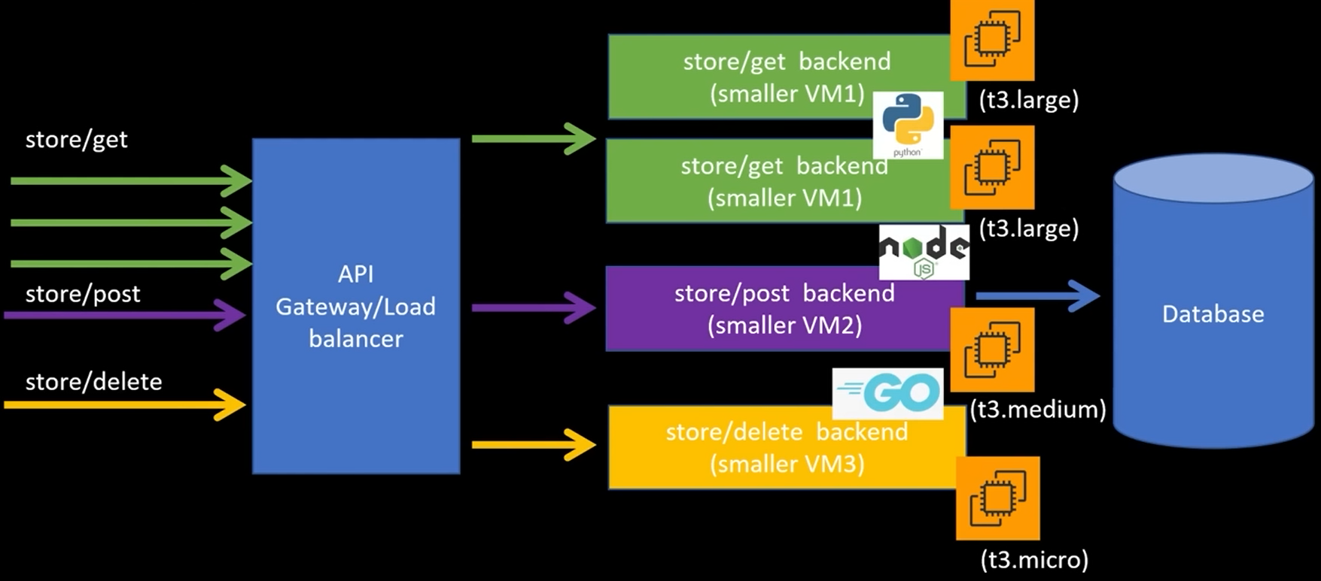
Solution of scaling
Notes:
Polyglot - using more than one languages.

Slide 22
Characteristic of Microservices
Independent
Scaling
Governance
Deployment
Testing
Functionality
(Not required to follow every characteristic)

Slide 23
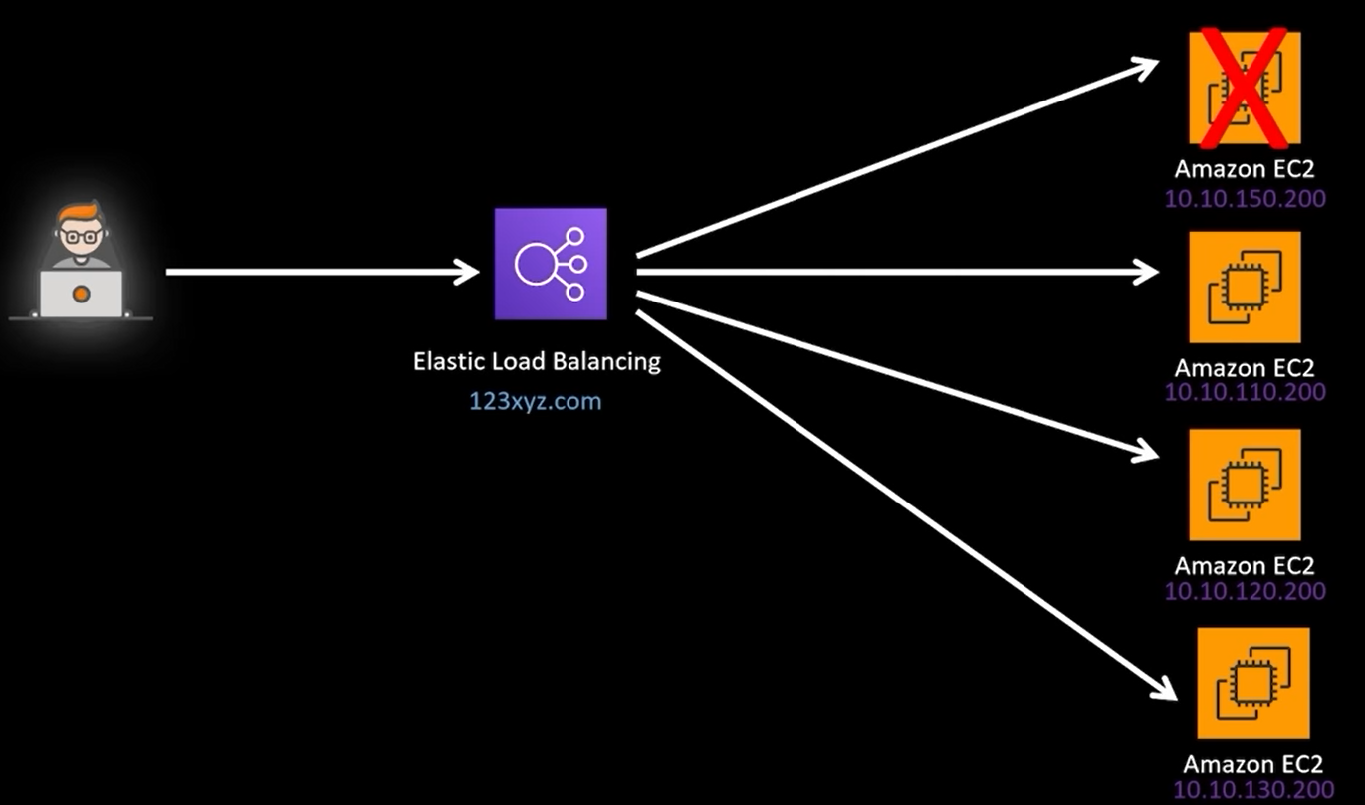
Load Balancer

Slide 24
Characteristics of load balancer
Automatically distributes incoming traffic across multiple targets
Monitors health of targets
Integrates with SSL
Notes:
Elastic - As traffic goes up the load balancer will also scale up.

Slide 25
Types of Load Balancer
Both ALB and NLB are load balancers provided by AWS, but they serve different purposes based on the OSI Layer, traffic type, and feature
Application Load Balancer
Network Load Balancer

Slide 26
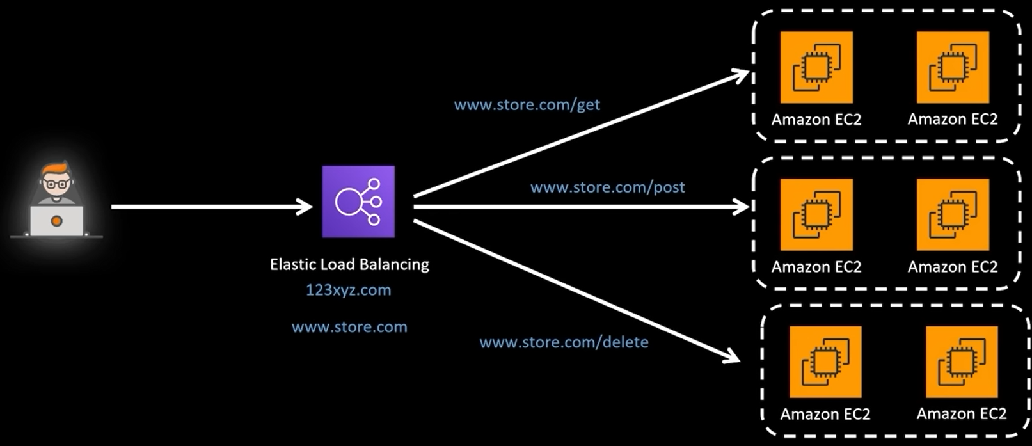
Application Load Balancer

Slide 27
Application Load Balancer
Operates on OSI Layer 7 (Application)
Routes traffic based on HTTP/HTTPS (URLs, headers, cookies, query strings).
Supports path-based & host-based routing (e.g., /api vs. /admin can go to different servers).
Supports SSL termination (decrypts HTTPS traffic before passing it to backend servers).
🛠 Best Use Cases:
✅ Websites, APIs, and microservices. ✅ Routing requests to multiple services based on URL paths or domains. ✅ Applications needing authentication and security. ✅ Applications that require sticky sessions.

Slide 28
Network Load Balancer
Operates on OSI Layer 4 (Transport)
Routes traffic based on IP and port (TCP, UDP, TLS).
Designed for extreme performance (can handle millions of requests per second).
Lower latency than ALB (sub-millisecond).
SSL pass through by default
🛠 Best Use Cases:
✅ Real-time applications (VoIP, gaming, financial apps). ✅ Load balancing TCP, UDP, and TLS traffic (e.g., databases, SMTP, MQTT). ✅ Applications needing low latency and high performance. ✅ Services that require a static IP address.

Slide 29
ALB or NLB?
✔ Use ALB for web applications, APIs, and microservices that require routing, authentication, and SSL termination. ✔ Use NLB for real-time, high-performance applications like games and financial apps.
🚀 If you're running a modern web app → Go for ALB. 🚀 If you need high performance & low latency → Go for NLB.

